Slide 1
CS 408
Computer Networks
Chapter 03: Traditional Applications

Slide 2
Terminal Access – Telnet
History
Oldest Internet application
First published version RFC 97
  "First Cut at a Proposed Telnet Protocol," February 1971
Final form issued as RFC 854 and RFC 855 in 1983
  (Get and study these RFCs – see last slide)
Still useful Internet application (if you ignore security problems ☺ )
  Also pioneering effort for application-level protocol design
Basis of many newer protocols such as HTTP
A protocol by Jon Postel
  See RFC 2441for a tribute about him
  http://www.isoc.org/postel/ for more info

Slide 3
Remote Terminal Access
Early motivation for networks was remote access to mainframe systems
Dumb terminals (see figure on the next slide)
  Keyboard and screen with primitive comm. hardware
  Local host computer establish connection to remote host
The challenge is that terminals and host systems were not standardized
  the local host should be on the way to connect to the remote host, because local terminal was not speaking the same language as the remote host

Slide 4
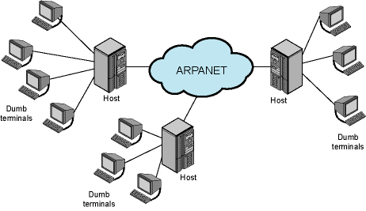
Operational Environment on Arpanet

Slide 5
Network Virtual Terminals
The approach to solve the problem of lack of a common language was to define a common language
Transform characteristics of terminal into standardized form
  Network virtual terminal (NVT)
  Imaginary device with well defined set of characteristics
Both sides generate data and control signals in native language but translates them to NVT form
  The sending side translates native data and control signals into NVT form before sending out
  the receiving side gets the NVT data and signals and translates into its native form

Slide 6
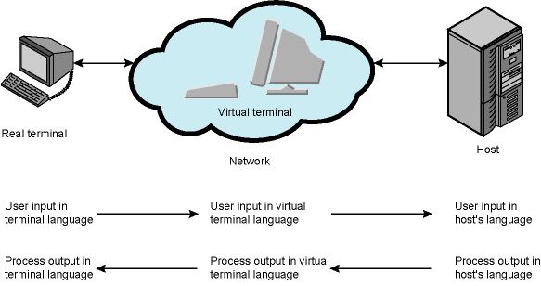
Network Virtual Terminal Concept
Terminal with client telnet software and NVT translation support
Remote host with server telnet software and NVT translation support

Slide 7
Phases of operation
Connection management
  Connection request and termination
  Telnet uses TCP (port 23)
Negotiation
  To determine mutually agreeable set of characteristics and options
Exchange of control information / commands (e.g. backspace, end of line), and transfer of data between two correspondents
A typical telnet session is exchange of data/control information between terminal and host
  Multiple rounds
  Not only for accessing remote accounts; was also used for information system query
    Once upon a time telnet was being used to query library catalogues.
    Currently all discountinued
Notes:
<number><number>

Slide 8
Telnet – Data and Control Transmission
Data sent as stream of bytes
  No other formatting
  Each byte is processed one by one
Commands are embedded in data stream
  using a delimiter byte called “Interpret as Command” (IAC) which is 255
    after 255, a command comes
    so what happens if there is a data byte with value 255?
  See Table 3.1 of Stallings for a list of commands
Protocol minimizes transmission overhead
  No message headers
But processing overhead is high
  due to char by char processing

Slide 9
Telnet Options
Enable two sides to use capabilities beyond default NVT
  may change, enhance or refine NVT characteristics
  may change transfer protocol
Not part of Telnet protocol specification
  published in other RFCs
See Table 3.2 of Stallings for a list of some telnet options

Slide 10
Option Negotiation
Negotiation allows one side to request an option
  Other side may accept or reject
  If accepted, effective immediately
  Negotiation can be done at any time after connection is established, but usually just after the connection
Either side may initiate negotiation
Rules to be obeyed
  You may accept or reject a request to enable an option
  You must always accept a request to disable an option
  Options are not enabled until the negotiation is complete

Slide 11
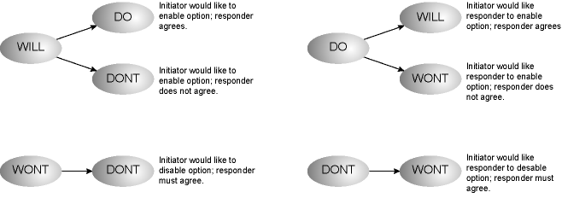
WILL - WONT - DO - DONT
4 option negotiation commands
  option ID follows them
  Each negotiation command takes 3 bytes
Interpretation of commands depends on where they are used (initiator or responder)

Slide 12
The Longevity of Telnet
Telnet is probably older than all of you
  but not older than me ☹
Telnet is simple
  RFC 854 is 15 pages
  HTTP (we will see later) is 176 pages
  Simple job done by simple protocol
The idea of option negotiation was a very good design feature
  Enables Telnet to evolve to meet new demands without endless new versions of the basic protocol
Currently over 100 RFCs on Telnet and its options
  ~2% of the entire body of RFCs

Slide 13
Electronic Mail
One of the most heavily used application on any network
Simple Mail Transfer Protocol (SMTP)
  work on TCP/IP
  Delivery of simple text messages
Multi-purpose Internet Mail Extension (MIME)
  Other types of data
  Voice, images, video clips, executables, etc.
  works on SMTP

Slide 14
SMTP
RFC 821 (later updated)
Not concerned with format of messages or data
  Message format is covered in RFC 822 (see later)
SMTP is just for message transfer using info written on envelope of mail
  Message header
Does not look at contents
  Message body
Of course the latter two bullets are valid if the SMTP implementation is an honest one!
Conventions
  Standard character set: 7 bit ASCII
  Add log info to the beginning of the message to show the paths taken

Slide 15
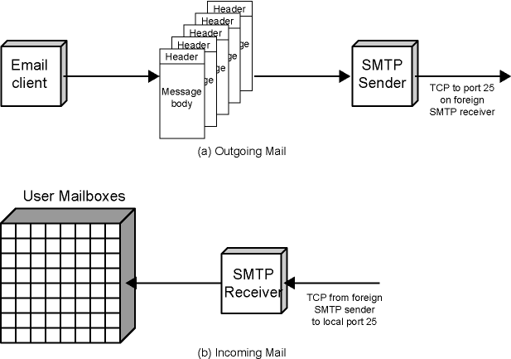
SMTP Mail Flow
Mail Queue
Internet

Slide 16
Mail Message Contents at the Mail Queue
RFC 822 header that contains the sender, list of recipients, subject, date, etc.
Message body, composed by user
Mail destinations
  Derived from header

Slide 17
SMTP Sender
Takes message from queue
Transmits to proper destination host
  Via SMTP transaction (sequence of SMTP commands)
  Over a TCP connection to port 25
When delivery complete, sender deletes destination from list for that message
When all destinations processed, message is deleted
Optimization
  Message body sent once over a single SMTP connection to multiple recipients on a single host

Slide 18
SMTP Receiver
Accepts arriving message
Places in user mailbox or copies to outgoing queue for forwarding
Sender responsible for message until receiver confirms complete transfer
  Indicates mail has arrived at host, not user has received the message

Slide 19
Possible Errors
Receiver SMTP server may be unreachable at that time
TCP connection may fail during transfer
In those cases (transient problems), sender re-queues mail
  Give up after a period of time
Faulty destination address
  bounces back to the sender

Slide 20
SMTP Protocol - Reliability
TCP provides a reliable connection
No end-to-end acknowledgement to originator (unless return-receipt is used)
  However, if not delivered, an error message comes back to the originator
No guarantee to recover lost messages
  e.g. due to an OS related problem after SMTP receiver gets the message
A common problem
  A legitimate email may be considered as spam and may go to trash/spam folder
Despite all, generally considered reliable

Slide 21
Scope of SMTP
SMTP is limited to conversation between sender and receiver
Main function is to transfer messages
Rest of mail handling process differs among systems
If the client does not run a mail sender, then it asks a server to do so
  Generally via SMTP
    Client acts as a sender
    Server acts as a relay (forwarding point)
Recipients access their mailboxes via
  Email client programs (such as Thunderbird, MS Outlook)
    POP3 (Post Office Protocol)
    IMAP (Internet Mail Access Protocol)
  Web based systems

Slide 22
SMTP System Overview
Commands and responses between sender and receiver over a TCP connection
  Sender sends commands to receiver
  Each command generates exactly one reply
Basic SMTP operation
  Connection setup
  Mail transfer (incl. related commands)
  Connection termination
    QUIT command that closes the TCP connection

Slide 23
Connection Setup
Sender opens TCP connection with receiver
  Sender connects port 25 of the receiver
Once connected, receiver identifies itself
  220 <domain> service ready
If mail service not available, instead of 220
  421 service not available
Sender identifies itself
  HELO <domain name>
Receiver accepts sender’s identification
  250 OK

Slide 24
Mail Transfer
Sender may send one or more messages to receiver
MAIL FROM: command identifies originator
  Receiver returns 250 OK or appropriate fail/error message
One or more RCPT TO: commands identifies recipients for the message
  Separate reply for each recipient: accept, reject, etc.
DATA command transfers message text
  End of message indicated by line containing just period (.)

Slide 25
SMTP Replies
Leading digit indicates category
  Positive completion reply (2xx)
  Positive intermediate reply (3xx)
  Transient negative completion reply (4xx)
  Permanent negative completion reply (5xx)
See Tables 3.4 and 3.5 of Stallings for the list of SMTP commands and replies.

Slide 26
RFC 822
Format for text messages
Message is sequence of lines of text
  Uses general memo framework
  A header line is of form
    keyword : arguments/values
  Example
      Date: Tue, 30 Sep 2014 08:55:58 (EST)
      From: Albert Levi <levi@sabanciuniv.edu>
      Subject: Networking is fun
      To: CS408-201401@sucourse.sabanciuniv.edu
      Cc: president@whitehouse.com
      This is the main text, delimited from the header by a blank line.

Slide 27
Relaying
In SMTP terms, relaying means asking an SMTP sender to deliver an email on behalf of:
  another SMTP server, or
  an email client
Relaying is quite dangerous since it is one of the main enablers of spam
  sending SMTP servers should enable relaying only for local senders
    Can be checked via domain name control
    May require authentication

Slide 28
ESMTP and Authentication
SMTP Service Extensions
  defined in some RFCs after RFC 821
    EHLO (Extended HELO)
      Server returns supported extensions and SMTP features
    Some new parameters for existing SMTP commands
  RFC 2821 published to cover core SMTP + extensions
RFC 2554 added authentication feature to SMTP
  AUTH command

Slide 29
Multipurpose Internet Mail Extension (MIME)
Extension to RFC822
SMTP is only for 7-bit ASCII text messages, can not transmit executables
  uuencode and other schemes are available
    Not standardized
Cannot transmit text including international characters (e.g. ö, ç, ğ, â, å, ä, è, é, ê, ë)
MIME is intended to solve these problems
  to be used over SMTP
  compatible with RFC 822
MIME is actually a framework to handle attachments

Slide 30
Overview of MIME
New message header fields (to be included in RFC 822 header)
  MIME version
  Content type
    description for the data (text, audio, video, image, etc..)
  Content transfer encoding
    Data should be encoded such that SMTP can carry
    This field describes the encoding mechanism used
  Content Description
    plain text description for the object in the body
    optional, used when an explanation for the attachment is needed

Slide 31
Content Types (some of them)
Text body (unformatted plain text)
  ASCII or ISO 8859 charset
  a different charset may be defined at content-type header field
Multipart
  multiple independent parts, each may be of different type
  separated by a boundary (a random-like string) for which value is defined at content-type header field
  Four subtypes: Mixed, Parallel, Alternative, Digest
  Multipart/mixed different parts bundled in a particular order
  Multipart/parallel different parts but the order is not important
  Multipart/alternative same content but alternative representations
Message/RFC822
  the content is an entire message (including header and body)
  despite its name, the embedded message can be of any MIME type
  what is the use of this content type?

Slide 32
Content Types (some of them)
Image
  jpeg, gif, etc.
Video
  Mpeg, etc.
Audio
Application
  binary data to be processed by an external application
    attachments of any type
  application name is a subpart
    msword, postscript, pdf, etc.

Slide 33
MIME Transfer Encoding
Reliable delivery across various environments
Content-transfer-encoding field
  Six alternative methods
  For three of them (7bit, 8bit, binary), no encoding done
    Only 7-bit is safe for SMTP
X-token
  nonstandard encoding
  vendor or application specific (name of encoding is to be supplied)
Quoted-printable
  Useful when data are mostly printable ASCII characters
  Non-printable characters represented by hex code
  See the rules in the book
Base64 (Radix-64)
  Maps arbitrary binary input onto printable output (33% overhead)

Slide 34
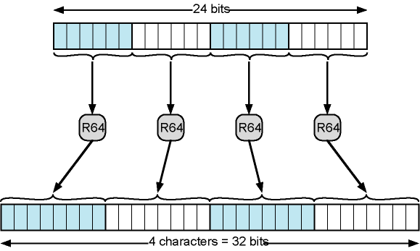
Printable Encoding of Binary Data into Radix-64 Format

Slide 35
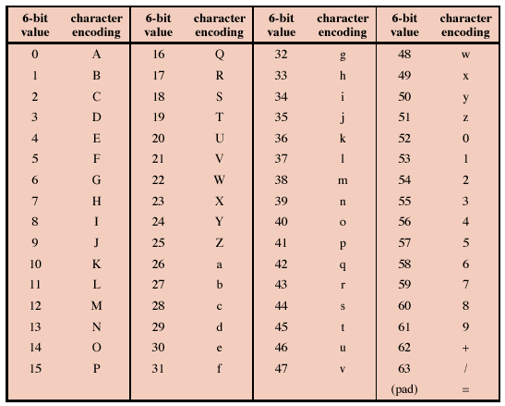
Radix-64 Encoding Table

Slide 36
FILE TRANSFER—FTP
FTP evolved from an era of diverse systems (as telnet)
Has variety of commands, transfer modes, and data representations
  some are obsolete, e.g. EBCDIC support
Deals with file systems, rather than just files
  including file pathnames, directory listing, access control
Defined in RFC 959 (69 pages long)

Slide 37
FTP Model
User FTP entity and Server FTP entity
Initiating host is user, server listens on port 21
  First sends username and password to identify him/herself
Server first authenticates the user
Then user sends a request (e.g. to retrieve a file)
Then server accepts or rejects request
  Based on its file system protection and options requested
  If accepted, server transfers the requested data.
Operates on two levels (see next slide for a figure)
Transfers are over TCP connections
  Exchange control information (commands and replies) - one TCP connection
  Second TCP connection established for data transfer

Slide 38
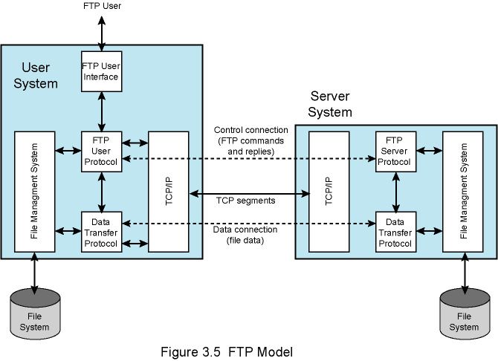
FTP Model

Slide 39
FTP Commands
Access Control
  Username (USER) and password (PASS) commands
Specify parameters for data connection
  Data port (PORT command), or Passive Mode (PASV command), shall see in the next slide
  transfer mode, representation/data type, and structure
    only some of them are implemented in today’s ftp server and clients.
File system operations
  Store (STOR), retrieve (RETR), append (APPE), delete (DELE), etc.
Directory navigation and listing
  Change directory (CWD), Make Directory (MKD), Print current directory (PWD)
  Directory listing (LIST)

Slide 40
Data Transfer
Two alternative methods: Active and Passive
Active Mode: user "listens" on specified data port
  using the command PORT a1,a2,a3,a4,p1,p2
  a1 .. a4 are 4 octets of the user’s IP address
  p1 and p2 is for the port that the user should listen
    actually calculated as (p1*256+p2)
  Server initiates data connection and data transfer
An alternative is Passive Mode
  by just sending command PASV (user sends PASV before the data transfer request)
  server listens to a specific port and user should access that port
    The IP address and port is sent to the user as the response of PASV command
  we shall see a real example
  A good article on how FTP works (Please have a look at)
http://www.freefire.org/articles/ftpexample.php
If the link is broken try http://zoo.cs.yale.edu/classes/cs433/cs433-2016-spring/readings/FTP-example.pdf

Slide 41
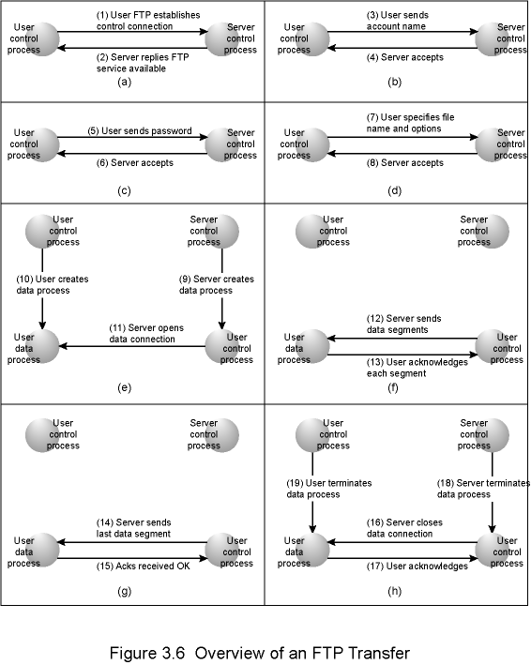
Overview of an FTP
Transfer
Let’s see a real example!
Active data transfer using PORT command

Slide 42
Options
FTP assumes that files are objects in mass storage and share some properties regardless of machine
  Files uniquely identified by symbolic names
  Files have owners and protection against unauthorized access
  Files may be created, read from, written into, or deleted (within protection rules)
To support specific computers and operating systems, FTP can negotiate options in three dimensions
  Data/representation type, file type, and transfer mode
Not all of those options are important, several of them are not implemented

Slide 43
Data/Representation Types
Important ones ASCII and Image (binary)
FTP command to change data type is “TYPE”
  parameter is either A or I
Text files normally stored as character string
  8-bit ASCII on most machines
Image transfer is bit-by-bit replication of file from the source machine on the target machine
  that is why in most ftp clients the corresponding command is called “binary”

Slide 44
File Types
How the file is represented during transfer
File structure, record structure, and page structure
  but only file structure is supported in most FTP servers and clients
File structure
  String of bytes that terminates in an end of file marker
  Most transfers use this type (default one)
No need to play with it but if you are curious,
  the corresponding command is STRU and parameters are F, R and P

Slide 45
Transmission Modes
Stream mode (default)
  Raw data sent over the TCP connection
  Least computational burden on user and server systems since there is no processing
Block Mode
  Allows failed or interrupted transfers to be restarted where it left off
  Source encapsulates data into blocks
    3 bytes of overhead for each block (of max. 65536 bytes)
Compressed Mode
  Simple compression mechanisms
    Such as specifying count for replicated data
FTP command MODE is used to set transmission mode
  parameter S for stream (default)
  parameter B for block mode
  parameter C for compressed mode

